Slide 1

Z-SAT Bank System – Full Explanation
This presentation provides a comprehensive overview of the Z-SAT Bank System, a console-based banking management system developed in C++. We will explore its functional modules, technical concepts, security features, limitations, and educational value. The system is designed to simulate basic banking operations and provides a learning experience in C++ programming.

Slide 2
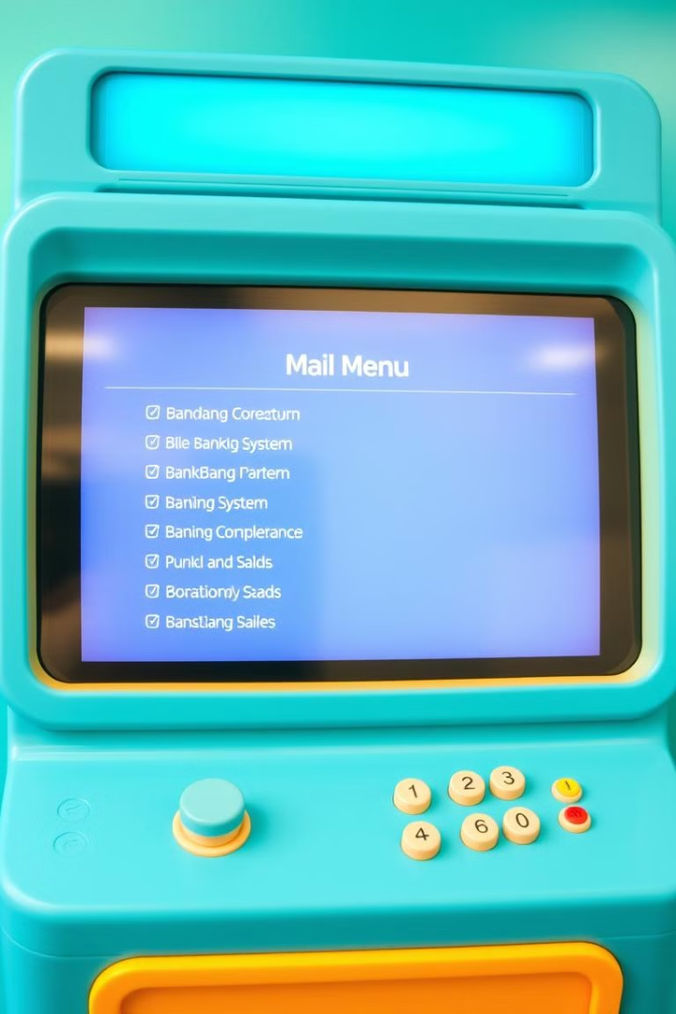
Main Functional Modules
The Z-SAT Bank System offers several key functional modules accessible through a main menu. These modules include the ATM system, which allows users to perform basic banking transactions, and an account creation system for opening new accounts. There are also modules for managing existing accounts, currency conversion, and loan eligibility checks.

Slide 3

ATM System
The ATM system is the core component of the program, facilitating essential banking operations. The login process requires users to enter their account number and PIN. The system validates this information against stored data, allowing a maximum of three attempts. Upon successful login, users can check their balance, deposit funds, and withdraw amounts, subject to sufficient balance availability. The system uses arrays to store and manage user account data.

Slide 4
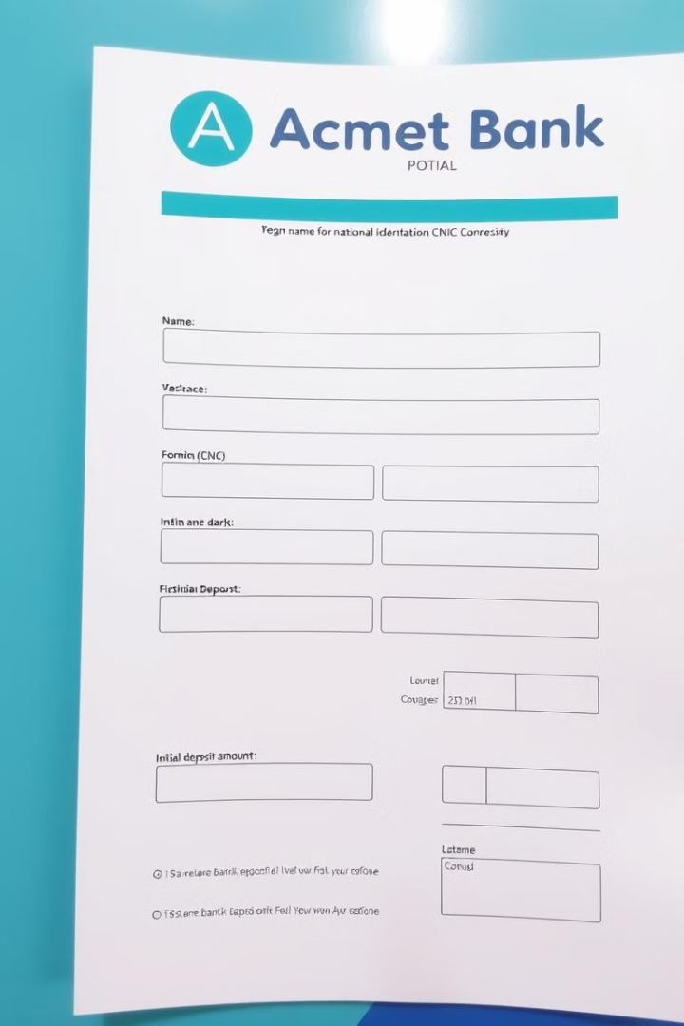
Account Creation System
The account creation system allows new users to open a bank account by providing their name, CNIC (a unique 13-digit identifier), and an initial deposit amount. The system then generates a unique account number and a random 4-digit PIN. This information is stored in arrays, including names, CNICs, PINs, account numbers, and balances. Due to the array size, a maximum of 10 accounts can be created. The system verifies the uniqueness of the CNIC to prevent duplicate accounts.

Slide 5
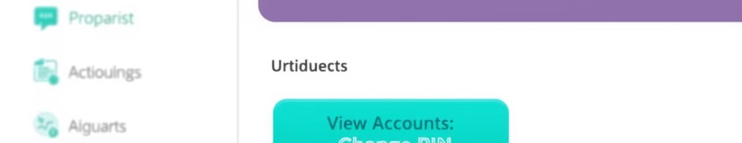
Account Management System
The account management system provides options for users to manage their existing accounts. These options include viewing all accounts, changing a PIN, and deleting an account. Viewing all accounts displays detailed information such as the account holder's name, CNIC, account number, and balance. The change PIN option requires the user to enter their CNIC for verification before allowing them to update their PIN. Deleting an account involves replacing its data with the last account in the array and decrementing the total count.

Slide 6
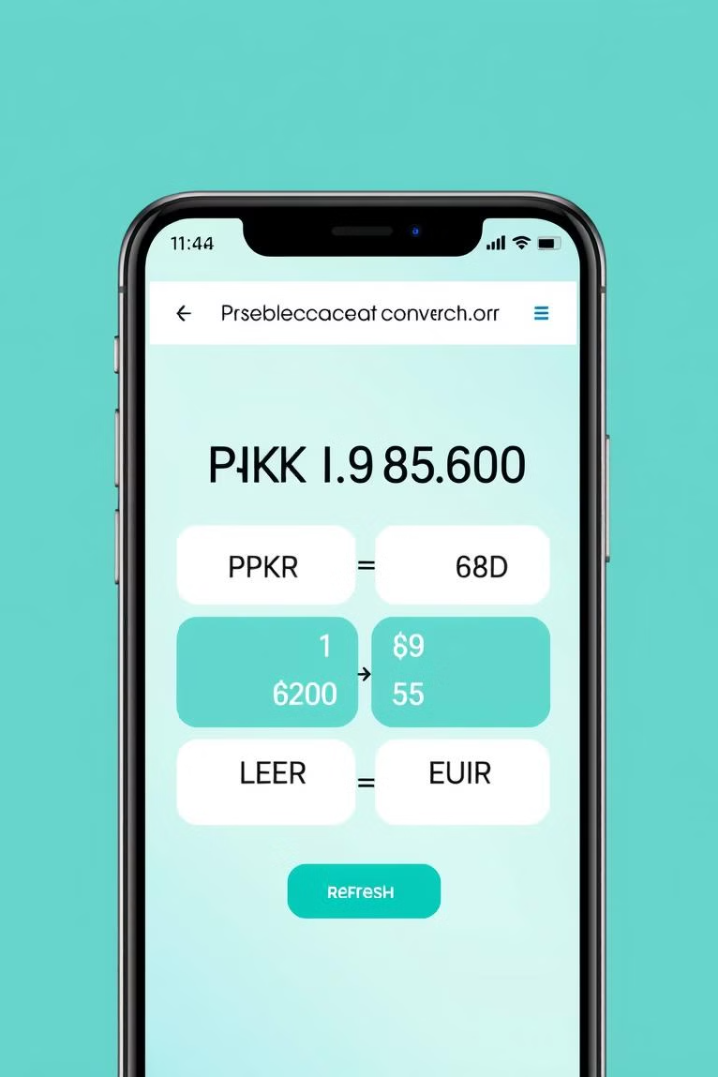
Currency Converter (Planned)
This module is a planned feature that aims to provide currency conversion functionality. It will allow users to convert local currency (PKR) to foreign currencies such as USD and EUR. The module will accept an amount in PKR and display the converted values using either fixed or API-based exchange rates. This feature enhances the system's utility by providing a convenient way to perform currency conversions within the banking environment. The module's implementation is slated for future development.

Slide 7

Loan Eligibility Checker (Planned)
Another planned feature is the loan eligibility checker, designed to assess a user's eligibility for a loan based on their financial information. It will prompt users to enter their monthly income and expenses. The system will then apply a predefined formula or threshold to determine whether the user is eligible for a loan. The result will be displayed as "Eligible" or "Not Eligible," providing a preliminary assessment of loan eligibility. This module adds value to the system by offering a basic loan qualification tool.

Slide 8
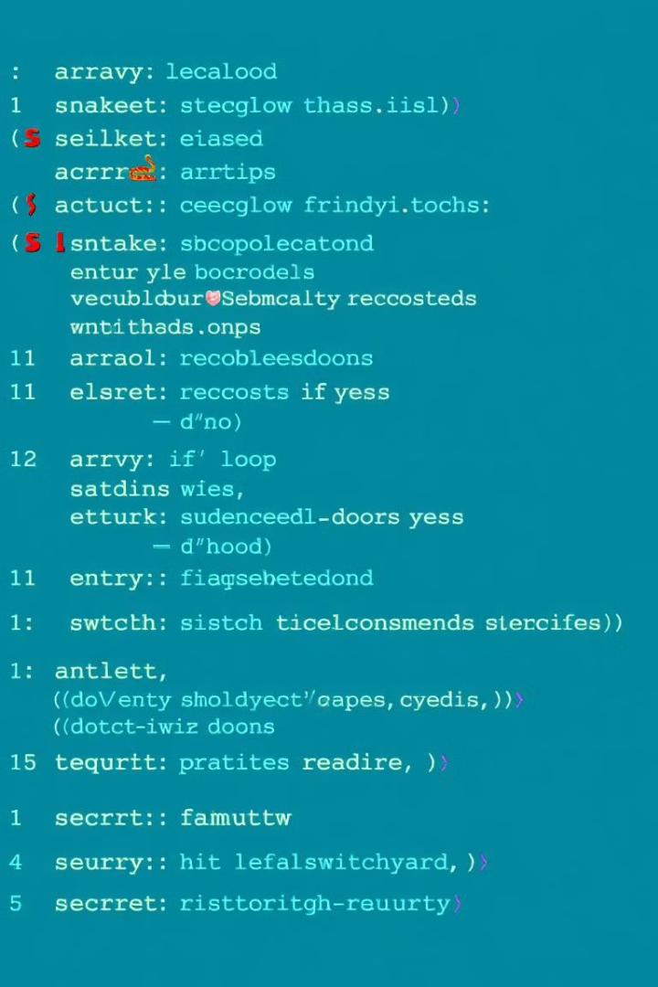
Technical Concepts & Security Features
The Z-SAT Bank System utilizes several fundamental programming concepts, including arrays for storing user data, loops for repetitive actions, if-else statements for decision making, and functions to modularize code. A switch statement is used to efficiently handle menu choices. Security features include a three-attempt lock on the ATM system to prevent unauthorized access, CNIC validation to ensure uniqueness, and random PIN generation to enhance account security. These features contribute to the system's overall functionality and security.

Slide 9
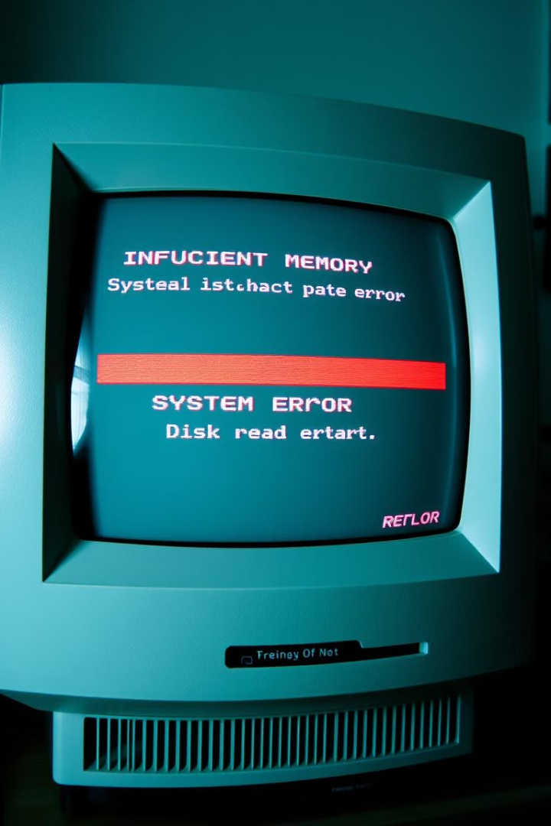
Limitations
The Z-SAT Bank System has several limitations due to its design and scope. It lacks permanent data storage, meaning that data is not saved between sessions. The system is limited to a maximum of 10 users due to the fixed size of the arrays. There is no encryption or password masking, which could pose security risks. Additionally, the system lacks a graphical user interface (GUI) and mouse interaction, relying solely on text-based input. These limitations highlight areas for future improvement.

Slide 10

Educational Value & Example Use Case
This project offers significant educational value for students learning C++. It provides practical application of basic to intermediate C++ concepts, real-world usage of arrays and conditionals, and logical structuring of a multi-feature program. As an example, a user named Zaq creates a new account, logs into the ATM system, and performs basic transactions, illustrating the system's core functionality. This hands-on approach helps reinforce programming skills and concepts.

